Slide 1
Kevin Hogan Sales Success System
The First system that works every time

Slide 2
0.9 Agreement and Pen on Table
Get settled in the space then join them in their world.

Slide 3
1. Landscape Effect
Meet them in THEIR WORLD. Be Comfortable THERE
Take them to your solution when you identify with each other.

Slide 4
1.5 Landscape Effect
KNOW what is happening in THEIR Mind. Do you really know who they are?
Cause them to KNOW they are NOT making a mistake talking with you, while in their world.
Your desired outcome? “That’s a Good idea Honey, go buy that today!”

Slide 5
1.6 Then bring them to Your World (Landscape)… to you the person & your Product/Service…that solves their problem.
…Ultimately, You will bring them to agreement

Slide 6
0) Reactance and Resistance pt. 1
They Fear Loss of Control, Manipulation, Their own Poor Decision Making, and the Rolodex in their Mind
And MUST SAY “NO!”

Slide 7
0.1 How Resistance and Reactance Manifests Itself
They will be hostile
They will use control ploys, perhaps even keeping the office door open
They might act as if they own your stuff and invade your personal space

Slide 8
0.5 Your Response? Be Comfortable
Interrupt their Resistance -
“Could I have a glass of water?”
Be comfortable in their environment

Slide 9
0.55 Examples of Possible Resistance Responses
Stub your toe
Drop a cup of WATER
Let his office “hurt you”
Let the coffee be too hot

Slide 10
0.555 More Possible Responses to their Resistance
Let the coffee be TOO HOT
Look at the wall and say, “What in the world is that?”
Tie your shoe
Take your coat off

Slide 11
0.55555 After Your Response
Create a buying moment with a smart phone interruption
You must switch from bottom up to top down thinking. BUT….If you don’t have trust and certainty, you cannot ask for their business, yet.

Slide 12
0.678 The “Power Flip” - Response to Resistance
You are here for them to ask for your help
A SMALL disruption reduces their tension
Tension + Desire = Attention

Slide 13
2.0 Must be Credible to Sell
A) Be Competent
1) they must observe you (something they don’t know)

Slide 14
2.05 The Credible You
B) Trustworthiness
1) Likeable
2) Competence

Slide 15
2.1 The Credible You
3. Other Orientation
4) Dependable
- On time
- Deliver what you promised

Slide 16
2.25 Credibility
5) Expertise
6) Sociable
7) Composure

Slide 17
2.3 Evidence You are the Right Person
Who says you are great? (This confirms their observation!)
Who says your company is great?
Intelligent?

Slide 18
2.35 More Evidence You are THE Person
Trained?
Experience?
Endorsements and Testimonials?

Slide 19
2.7 Riding Your Market’s Wave
The Credibility Test and Door to the sale
You will have them do something they have never done before, “are you ok with that if it brings you a million dollars in business?”

Slide 20
2.73 Riding your Market’s Wave
Your idea is moving in synch with the market or die
The market is moving…away…From them

Slide 21
2.8 Unstoppable Why…NOW!
Give Three reasons to buy this product today.
1. Economic forces in your business are changing
2. Technology is changing FAST in your biz. (Story of Tonya and her web cam for $10,000!)
3. There are Changing Behavioral Patterns in your biz. Like what?

Slide 22
2.9 Behavioral Change in the Market?
“Dad I think of my phone as an extension of myself.”
It’s part of her identity.

Slide 23
3.0 Verbalize! Quickly Reveal Genesis
Birth/Genesis of your idea
- Everyone Loves a SHORT Genesis Story
- Generate Believability, Credibility for your presentation content

Slide 24
3.1 Make it Clear, “Why Now?!?!”
1) Summarize – Most important change in their business.
Discuss IMPACT of acting NOW or USING your product/you NOW.
“Punch” the impact button hard. No one has ever showed them this before.

Slide 25
3.3 Then Contrast X and Y
Tiny contrasts between x (their Status Quo) and y (your proposal) no longer work.
Differences for change and attention must be SIGNIFICANT.
“Why would I do business with them instead of the other millions? What is so different about them?

Slide 26
3.4 You vs. Competition
Compeition is marginal compared to the rest. In part it is your genesis story.
Your solution will not be a straight line up. It will be like a bull market.
Things WILL go wrong and you will tell them and THEY will be shocked by your honesty and TRUST YOU.

Slide 27
3.7 Preach Failure Allowance to Client
Your honesty is UNIQUE
Pressure on Client is Removed

Slide 28
3.81 Introducing Your Idea/Solution
For (target customers)
Who are dissatisfied with (current situation)

Slide 29
3.82 Contrast Your Solution to Your Competition
My Product/Idea/Service (new idea in category)
That Provides (Key Problem/Solutions Features)
Unlike (Competing Product)
My product is (describe key feature)

Slide 30
3.83 Quick Central Message
3.9 Connect with story – someone who used your stuff and did something amazing with it.

Slide 31
4.0 Pain
4.0 Pain (Discuss ethics)
Pain may be days or weeks away…or it could be there NOW.

Slide 32
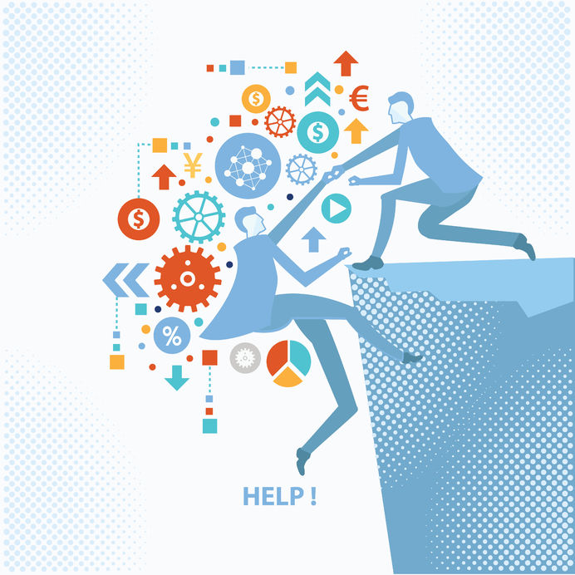
4.5 Isolate and Intensify

Slide 33
5.0 Release pain to THE (mystery) solution
Everything must FEEL better in addition to being better!

Slide 34
5.9 Real Solutions
They have real budgets. (They know what is real.)
They have real revenue and problems.
Have competitors – But you have an unfair advantage. What is yours?

Slide 35
6 & 7 Show, Prove and Note Benefits
6. Show them 3 Tactics / Proof for each one. (Story)
7. Solutions: Benefits and Features

Slide 36
8. Permission to Solve
“We’ve put together a cool answer that can solve this, would you like me to tell you?

Slide 37
Conclusion
9. Gifts/Bonuses/Options
10. Complete Form, Call to Action

Slide 38
Care the Most…and Be THE Real, Best Solution

